Slide 1
Extract, transform, load
MTN.BI.08
Transportation, Transformation and Loading
Elias Nema
Senior Software Engineer
Elias_Nema@epam.com

Slide 2
Agenda
Transportation in Data Warehouses
Transportation Using Flat Files
Transportation Through Distributed Operations
Transportation Using Transportable Tablespaces
Overview of Loading and Transformation in Data Warehouses
Loading Mechanisms
Transformation Mechanisms

Slide 3
Transportation in Data Warehouses

Slide 4
Overview of Transportation in Data Warehouses
Transportation is the operation of moving data from one system to another system. In a data warehouse environment, the most common requirements for transportation are in moving data from:
A source system to a staging database or a data warehouse database
A staging database to a data warehouse
A data warehouse to a data mart
Transportation is often one of the simpler portions of the ETL process, and can be integrated with other portions of the process.

Slide 5
Transportation Using Flat Files

Slide 6

Transportation Using Flat Files
The most common method for transporting data is by the transfer of flat files, using mechanisms such as FTP or other remote file system access protocols. Data is unloaded or exported from the source system into flat files using techniques discussed in "Extraction in Data Warehouses", and is then transported to the target platform using FTP or similar mechanisms.
Stage Area
Data Warehouse
Cleansing Stage
Source 1
Flat Binary Information
Meta Data
Aggregation Data
Raw Data
Source 2

Slide 7
Flat Files Summary
Because source systems and data warehouses often use different operating systems and database systems, using flat files is often the simplest way to exchange data between heterogeneous systems with minimal transformations. However, even when transporting data between homogeneous systems, flat files are often the most efficient and most easy-to-manage mechanism for data transfer.

Slide 8
Transportation Through Distributed Operations

Slide 9
Transportation Through Distributed Operations
Distributed queries can be an effective mechanism for extracting data. These mechanisms also transport the data directly to the target systems, thus providing both extraction and transformation in a single step. Depending on the tolerable impact on time and system resources, these mechanisms can be well suited for both extraction and transformation.
As opposed to flat file transportation, the success or failure of the transportation is recognized immediately with the result of the distributed query or transaction.

Slide 10
Database Links and SQL
A database link is a physical connection established between two databases; it can be created from source or target databases, pointing at the other. Essentially, using a database link is really a combination of extraction and transportation processing.
CREATE PUBLIC DATABASE LINK hr_link
CONNECT TO hr IDENTIFIED BY hr
USING '//192.168.56.101:1521/vd01dw';

Slide 11
Transportation Using Transportable Tablespaces

Slide 12
Transportation Using Transportable Tablespaces
Oracle transportable tablespaces are the fastest way for moving large volumes of data between two Oracle databases. Previous to the introduction of transportable tablespaces, the most scalable data transportation mechanisms relied on moving flat files containing raw data. These mechanisms required that data be unloaded or exported into files from the source database.

Slide 13
Check if Tablespace is Ready
CONN AS / SYSDBA
EXEC DBMS_TTS.TRANSPORT_SET_CHECK(ts_list=>'TEST_DATA', incl_constraints=> TRUE);
SQL>
SQL> SELECT * FROM transport_set_violations;
no rows selected
SQL> ALTER TABLESPACE test_data READ ONLY;
Tablespace altered.

Slide 14
Transportation Using Transportable Tablespaces
exp directory = '/temp/code/' transport_tablespace = Y tablespaces =ts_transportable file = test.dmp
expdp directory = dir_name transport_tablespaces=ts_transportable dumpfile = test.dmp
imp transport_tablespace = Y datafiles='/oracle/app/oracle/product/11.2/dbs/df_transportable' file = test.dmp
impdp directory = dir_name dumpfile = test.dmp transport_datafiles='/oracle/app/oracle/product/11.2/dbs/df_transportable’

Slide 15
Overview of Loading

Slide 16
Overview of Loading and Transformation
Data transformations are often the most complex and, in terms of processing time, the most costly part of the ETL process.

Slide 17
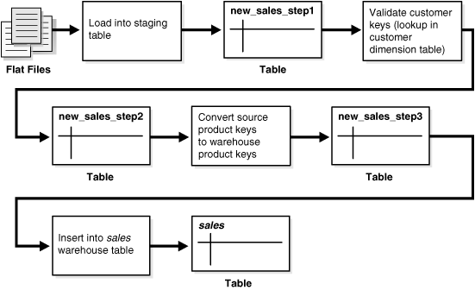
Multistage Data Transformation

Slide 18
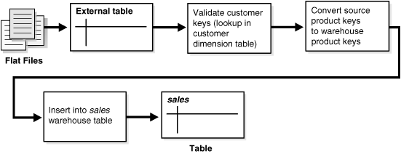
Pipelined Data Transformation

Slide 19
Loading/transformation mechanisms

Slide 20
Loading Mechanisms
You have the following choices for transforming/loading data inside the database:
Transforming Data Using SQL
CREATE TABLE ... AS SELECT And INSERT /*+APPEND*/ AS SELECT
Transforming Data Using UPDATE
Transforming Data Using MERGE
Transforming Data Using Multitable INSERT
Transforming Data Using PL/SQL
Transforming Data Using Table Functions

Slide 21
CTAS and Insert (Append)
In a data warehouse environment, CTAS and Insert Append is typically run in parallel using NOLOGGING mode for best performance.
INSERT /*+ APPEND NOLOGGING PARALLEL */ INTO …
CREATE TABLE tbl_name PARALLEL (DEGREE 4) NOLOGGING

Slide 22
SQL
UPDATE
If the data substitution transformations require that a very large percentage of the rows (or all of the rows) be modified, then, it may be more efficient to use a CTAS statement than an UPDATE.
MERGE
Oracle Database's merge functionality extends SQL, by introducing the SQL keyword MERGE, in order to provide the ability to update or insert a row conditionally into a table or out of line single table views. This is, besides pure bulk loading, one of the most common operations in data warehouse synchronization.
Multitable INSERT
External data sources have to be segregated based on logical attributes for insertion into different target objects: INSERT ALL|FIRST [WHEN condition THEN] INTO target [VALUES]

Slide 23
PL/SQL
Whereas CTAS operates on entire tables and emphasizes parallelism, PL/SQL provides a row-based approached and can accommodate very sophisticated transformation rules.
For example, a PL/SQL procedure could open multiple cursors and read data from multiple source tables, combine this data using complex business rules, and finally insert the transformed data into one or more target table. It would be difficult or impossible to express the same sequence of operations using standard SQL statements.

Slide 24
What is a Table Function?
A table function is defined as a function that can produce a set of rows as output. Additionally, table functions can take a set of rows as input.
To improve the performance of a table function, you can:
Enable the function for parallel execution, with the PARALLEL_ENABLE option, so that function can run concurrently.
Pipeline the function results, with the PIPELINED option. A pipelined table function returns a row to its invoker immediately after processing that row and continues to process rows. Response time improves because the entire collection need not be constructed and returned to the server before the query can return a single result row. (Also, the function needs less memory, because the object cache need not materialize the entire collection).

Slide 25
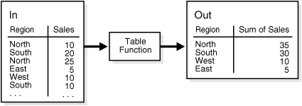
Table Function Example
INSERT INTO Out
SELECT * FROM (Table Function (
SELECT * FROM In));

Slide 26
Transportation, Transformation and Loading
Elias Nema
Senior Software Engineer
Elias_Nema@epam.com

